Slide 1
Object Oriented Programming IT-1203
Dr. Jesmin Akhter
Professor, IIT, JU

Slide 2
C++ fully supports object-oriented programming, including the three pillars of object-oriented development:
Encapsulation
Inheritance
Polymorphism

Slide 3
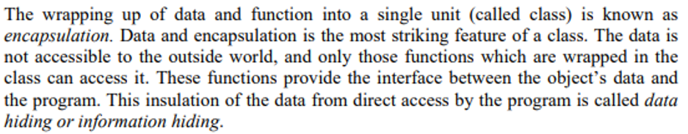
Data Abstraction and Encapsulation

Slide 4
Data Abstraction and Encapsulation
Encapsulation is the mechanism that binds together code and the data it manipulates, and keeps both safe from outside interference and misuse.
In an object-oriented language, code and data may be combined in such a way that a self-contained "black box" is created.
When code and data are linked together in this fashion, an object is created. In other words, an object is the device that supports encapsulation.
In OOP paradigm, "object" refers to a particular instance of a class.

Slide 5
Data Abstraction and Encapsulation
Within an object, code, data, or both may be private to that object or public.
Private code or data is known to and accessible only by another part of the object.
When code or data is public, other parts of your program may access it even though it is defined within an object.

Slide 6
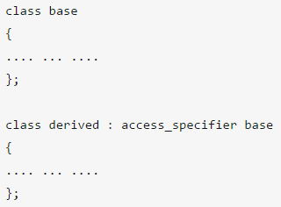
Inheritance
Inheritance is the process by which one object can acquire the properties of another object.
It supports the concept of hierarchical classification.
For example, a Red Delicious apple is part of the classification apple, which in turn is part of the fruit class, which is under the larger class food.
The derived class inherits all feature from a base class and it can have additional features of its own.
/* Note: Either keyword public, protected or private is used in place of access_specifier. */

Slide 7

C++ strongly supports the concept of reusability. The C++ classes can be reused in several ways. Once a class has been written and tested, it can be adapted by another programmer to suit their requirements. This is basically done by creating new classes, reusing the properties of the existing ones. The mechanism of deriving a new class from an old one is called inheritance. The old class is referred to as the base class and the new one is called the derived class or subclass. A derived class includes all features of the generic base class and then adds qualities specific to the derived class.
For example, a child inherits the traits of his/her parents. With inheritance, we can reuse the fields and methods of the existing class. Hence, inheritance facilitates Reusability and is an important concept of OOPs

Slide 8
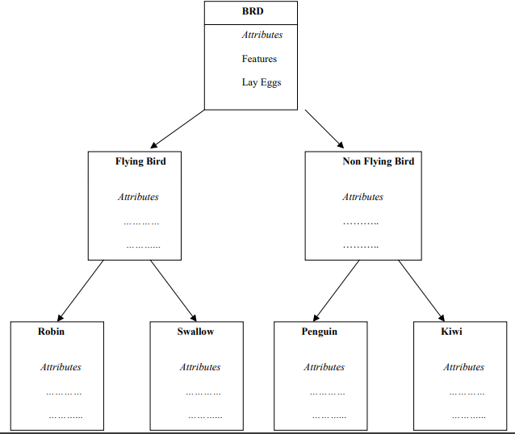

Slide 9
Polymorphism
Combination of two greek words
Poly-Many
Morphism-Form
Polymorphism-Many forms
One thing can be represented in many forms

Slide 10
Polymorphism
Polymorphism means to process objects differently based on their data type.
In other words it means, one method with multiple implementation, for a certain class of action. And which implementation to be used is decided at runtime depending upon the situation (i.e., data type of the object).
Ex1: A person→ in a shopping mall behaves like a customer.
A person→ in a bus behaves like passengers
A person→in school behsves like a student
A person→at home behsves like a sun/daughter
More than one function with the same name with different working.
Ex2: A man at a same time is a father, a husband, a employee.
So a same person posses have different behavior in different situations.
Ex3: Driver→ Pilot, Captain, bus driver

Slide 11
Thank you

Slide 12
Top-down Approach | Bottom-up Approach
A top-down approach is essentially the breaking down of a program to gain insight into its compositional small program (or module) in a reverse engineering fashion. | A bottom-up approach is the piecing together of module (or small program) to give rise to more complex program, thus making the original modules of the emergent program.
Structure / procedure oriented programming languages like C programming language follows top-down approach. | Object oriented programming languages like C++ and JAVA programming language follows bottom-up approach.
A top-down approach begins with high level design and ends with low level design or development. | A bottom-up approach begins with low level design or development and ends with high level design.
In top-down approach, main function is written first and all sub functions are called from main function thus, sub-functions are written based on the requirement | In bottom-up approach, code is developed from modules and then these modules are integrated with main function
In bottom-up approach first designing, beginning from the base level to the abstract level is done.
e.g.-In c++/java starts designing from class from basic level of the programming features and then goes to the main part of the program.

